Slide 1
Derivative Applications (1) Graphs
Derivatives can be used to sketch functions:
First Derivative:
-First derivative indicates slope
-if y’>0, function slopes increase
-if y’<0, function slopes decrease
-if y’=0, function slope is horizontal
-slope may change over time
Notes:
6

Slide 2
shape/concavity must be determined
Second Derivative:
-Second derivative indicates concavity
-if y’’>0, (concave upward); (minimum point).
-if y’’<0, (concave downward); (maximum point).
-if y’’=0, (an inflection point occurs)
Notes:
6

Slide 3
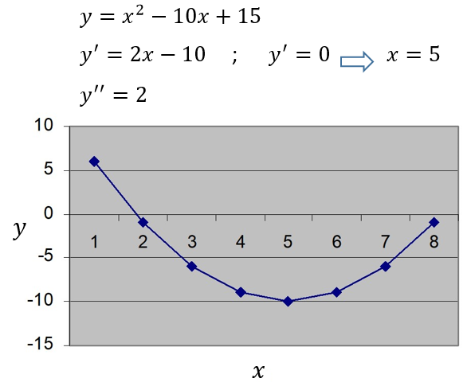
Sample Graphs
y’’= 2, graph is concave upward
Notes:
6

Slide 4
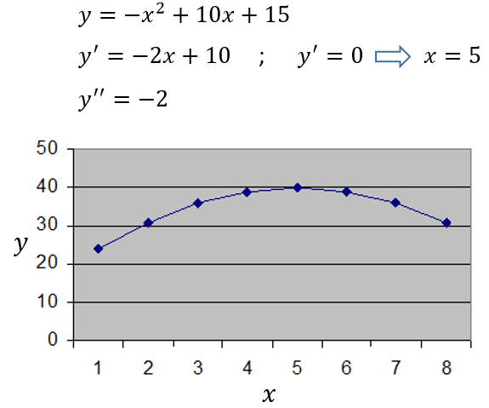
Sample Graphs
y’’=-2, graph is concave downward
Notes:
6

Slide 5
Critical Point
An interior point of the domain of a
function f where f’ is zero or undefined.
Maxima/minima can aid in drawing graphs
Maximum Point:
If 1) f(a)’=0, and
2) f(a)’’<0,
- graph has a maximum point (peak) at x=a
Minimum Point:
If 1) f(a)’=0, and
2) f(a)’’>0,
- graph has a minimum point (valley) at x=a
Notes:
6

Slide 6
Inflection Points:
If
1) f(a)’’=0, and
2) the graph is not a straight line
-then an inflection point occurs
-(where the graph switches between concave upward and concave downward)
Notes:
6

Slide 7
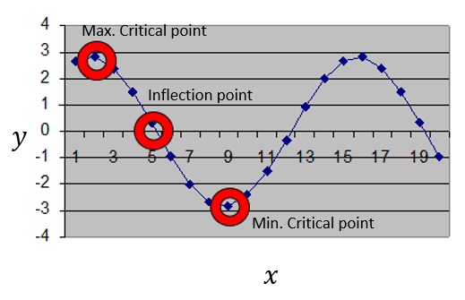
Notes:
6

Slide 8
Graphing Steps:
Evaluate y(x) at intersect with y-axis; (x=0).
Determine where y=0 at intersect with x-axis.
Calculate slope: y’ - and determine where it is positive and negative.
Identify possible maximum and minimum co-ordinates where y’=0. (Don’t just find the x values).
Notes:
6

Slide 9
v) Calculate the second derivative – y’’ and use it to determine max/min in iv.
vi) Using the second derivative, determine the curvature (concave upward or concave downward) at other points.
vii) Check for inflection points where y’’=0.
Notes:
6

Slide 10
Graphing Example 1
y=(x-5)²-3
y(0)=22,
y=0 when
(x-5)²=3
(x-5) = ± 3^{1/2}
x = ± 3^{1/2}+5
x = 6.7, 3.3 (x-intercepts)
iii) y’=2(x-5)
y’>0 when x>5
y’<0 when x<5
Notes:
6

Slide 11
y=(x-5)²-3
iv) y’=0 when x=5
y(5)=(5-5)²-3=-3
(5,-3) is a potential max/min.
v) y’’=2, (5,-3) is a minimum.
vi) Function is always positive, it is always concave downward.
vii) y’’ never equals zero.
Notes:
6

Slide 12
(0,22)
(3.3,0)
(6.7,0)
(5,-3)
Notes:
6

Slide 13
Graphing Example 2
y=(x+1)(x-3)=x²-2x-3
y(0)=-3,
y=0 when
(x+1)(x-3) =0
x = 3,-1 (x-intercepts)
iii) y’=2x-2
y’>0 when x>1
y’<0 when x<1
Notes:
6

Slide 14
y=(x+1)(x-3)=x²-2x-3
iv) y’=0 when x=1
f(1)=1²-2(1)-3=-4
(1,-4) is a potential max/min.
v) y’’=2, x=1 is a minimum.
vi) Function is always positive, it is always concave upward.
vii) y’’ never equals zero.
Notes:
6

Slide 15
Notes:
6

